Slide 1
“Where Interest and Passion
Unite to Confound All Order”
Corruption as State Formation in Early Colonial British India
“…if, in a country like [Britain], we are perpetually alarmed with supposed invasions of our rights, and frightful pictures of encreasing despotism are daily held forth to terrify the people, what a portrait might the dullest imagination exhibit of Bengal? By minds open to such impressions, little regard will be had…of men clamorously demanding the protection of laws ill understood and work applied, where interest and passion unite to confound all order, and where lordly traders, impatient of controul, hope to gratify their own sordid avarice in the general wreck.”
--Harry Verelst, A View of the Rise, Progress, and Current State of the English Government in Bengal, 1772
SSHA, November 2009
Nicholas Hoover Wilson
Ph.D. Candidate—UC Berkeley
nwilson@berkeley.edu

Slide 2
Corruption
The interpenetration of self-interested activity with the public duty of state officials (Scott 1972:4)
What happens when the boundary between private activity, economic behavior, and public duty among state administrators is not firmly entrenched?

Slide 3
New Directions
An empirical terrain in which the boundaries were not taken-for-granted
A theoretical framework linking the process of political conflict to corruption

Slide 4
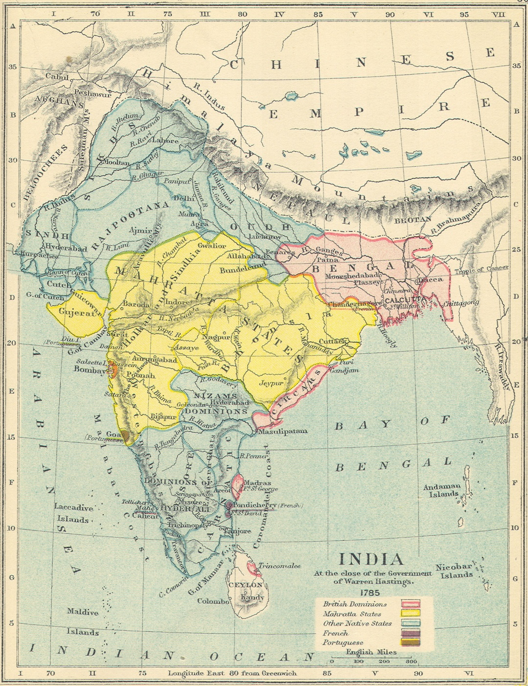

Slide 5
Early Colonial India (I)
Presidency structure
  Each had a Governor and a council, though the governor could be overruled by his council
The “country trade”
  Officials were poorly paid, and trading and lending money in the Indian interior was tolerated
Officials trained as merchants
      Promoted by seniority until 19th century

Slide 6
Early Colonial India (II)
Everyone was “corrupt”
  Little boundary between public and private interest
  Government, commerce, and sociability intertwined
  Clive “astonished at his own moderation”

Slide 7
18th Century Corruption
Corruption = decline of a regime balancing commerce (luxury), popular will (society), and the sovereign (the state)
How to stabilize corruption?
  The State (Hobbes)
    Corruption = political chaos and seduction of luxury
  Constitutional Checks (Montesquieu)
    Corruption = despotism and economic interest
  Economic Incentives (Steuart)
    Corruption = despotism

Slide 8
The Dynamics of Political Conflict
Substantive claims by parties about what corruption is and how to solve it
The Structural dynamics of the conflicts
  Who becomes involved and why

Slide 9
Escalation of Conflict
Observer
Faction
Observer
Conflict
Observer
Faction
Mobilization of Bias
Conflict Boundary

Slide 10
William Bolts in Bengal
Nawab of Bengal
Verelst
Calcutta Civilians
London
Bolts

Slide 11
William Bolts in Bengal (II)
British administration is chaotic and “corrupt”
  Bolts
    “That the Company is a Sovereign in the capacity of a merchant, and accordingly acts there in that double capacity; and that those who act under them are despots and merchants, as well for themselves as the Company: which are circumstances that must prove destructive to a commercial country.”
  Verelst
    “…a majority of the council viewed with jealous eyes every act of government. They considered all resistance to the privilege they claimed, as a settled determination to subvert the power of the company; and passion thus uniting with interest, they urged a measure of national policy with the little peevish petulance of a personal quarrel...”

Slide 12
William Bolts in Bengal (III)
Bolts
  Disorder from state entanglement with commerce
  Directly integrate India into the British state
  Colonial society stabilized by market exchange, guaranteed by the state
Verelst
  Disorder from subversion of Company authority
  Separate Britain and India
  Clearly empower the Company to deport Bolts
  Colonial administration stabilized by the state

Slide 13
The Nawab of Arcot’s Debts
Pigot
Nawab of Arcot
Madras Civilians
London
Council

Slide 14
The Nawab of Arcot’s Debts (II)
Pigot
  Disorder from subaltern’s disobedience
    Guilty of “an act subversive of the authority of government and tending to introduce anarchy”
  Solution: empower the Governor
Conspirators
  “…the unexampled outrage offered to the constitution, and arbitrary behavior towards two of our members, by an illegal attempt to suspend them…the public safety is in danger by the conduct of Lord Pigot, and you gentlemen, who have supported, and by every person, who shall continue to support such measures; and we shall hold you therefore responsible for all the consequences that may ensue…”
  Disorder from Pigot’s Tyrannical activity

Slide 15
Competing Styles of Self
Bernard Mandeville
  “I believe Man… to be a Compound of various Passions, that all of them, as they are provoked and come uppermost, govern him by turns, whether he will or no”
Adam Smith
  “The prudent man always studies seriously and earnestly to understand whatever he professes to understand, and not merely to persuade other people that he understands it; and though his talents may not always be very brilliant, they are always perfectly genuine. He neither endeavors to impose upon you by the cunning devices of an artful impostor…nor by the confident assertions of a superficial and impudent pretender.”

Slide 16
Macpherson Versus Cornwallis
Sept., 1786: “Macpherson is perfectly cordial, and all promise a most hearty support.” (Cornwallis to Dundas, Ross, p. 226)
Jan. 1787: “…A trait which I heard of a Highlander, struck me exceedingly. Macpherson offered to take him by the hand, which the other declined, telling him in the height of his power as Governor-General, that it was not to be depended upon.” (Grant to Cornwallis, Ross, p. 268)
Sept. 1787: “I beg leave to assure you that I have every good disposition towards Sir John Macpherson…if he should return to this country, I am convinced that the most friendly co-operation and intercourse would subsist between us.” (Cornwallis to Macauley, Ross, p. 305-306)
Aug. 1789: “His flimsy cunning and shameless falsehoods seem to have taken in all parties; believe me that those who trust the most in him will be the most deceived...” (Cornwallis to Dundas, Ross, p. 428)
Nov. 1789: “…he is a very good-humored fellow; but I think him weak and false to a degree, and he certainly was the most contemptible and the most contemned Governor that ever pretended to govern.” (Cornwallis to Dundas, Ross, p. 454)

Slide 17
Conclusion
Early Modern Colonialism is a great place to study corruption
In 18th Century India, multiple solutions to the “problem” of corruption were possible
Effectiveness of different substantive reforms to corrupt administration comparatively unimportant

Slide 18
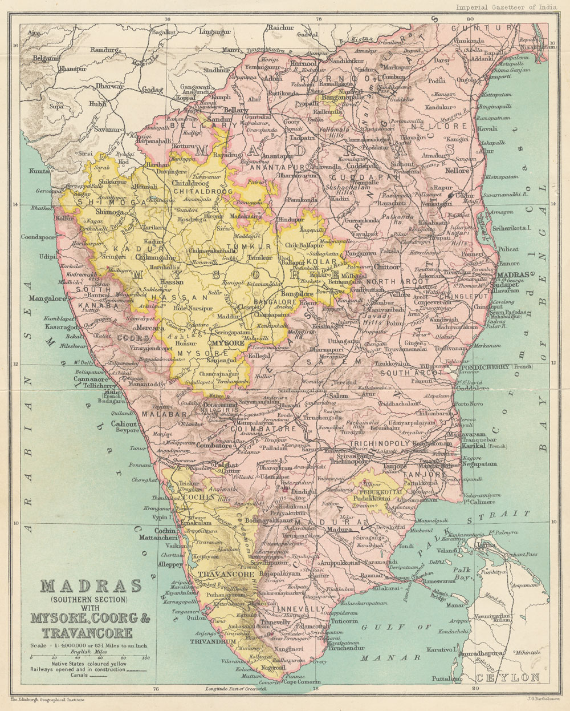

Slide 19
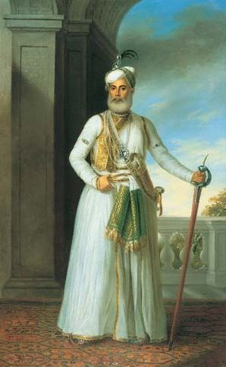

Slide 20
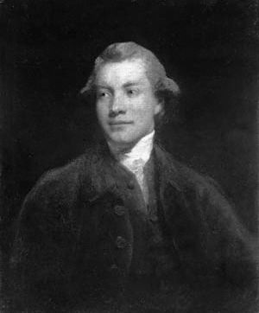

Slide 21
Macpherson and Bolts’ Careers
John Macpherson (c. 1745-1821)
Born in Scotland
1765: Purses about the East Indiaman Lord Mansfield
1768-1770: Agent of the Nawab of Arcot in London
1771: Appointed a writer to the EIC and assigned to Madras
1772-1773: Mayor of Madras
1776: Suspended from the Madras Council
1779-1780: MP from Crickdale; Election Nullified
1781:Returns to India
1796: Reelected to Parliament
1821: Dies in London
William Bolts (c. 1739-1808)
Born in Germany
1755: In Lisbon as a commercial agent
1759: Appointed Factor in EIC
1768: Ejected from India
1775: Mercantile agent for Maria Theresa in India
1784: Floats similar schemes to the French and Swedish
1808 Dies in Paris

Slide 22
William Bolts in Bengal
1759: Arrives in Bengal
1762: Writes “insubordinate” letter to the Nawab of Bengal
1766: Quarrels with superior at Benares
1768: Resigns and is deported from Bengal
1772: Publishes Considerations on Indian Affairs
1773: Henry Verelst publishes A View of the Rise, Progress, and Present State of the English Government in Bengal
Bolts wins his case in the Chancery court, but the Company indemnifies Verelst

Slide 23
Early Colonial India—What
The East India Company 1600-1858
  1700: Organized around factories in Bombay, Madras, and Bengal
  1757: Battle of Plassey in Bengal
  1754-1763: Seven Years’ War
  1765: Grant of Diwani in Bengal
  1770s: Territorial expansion in Madras

